Slide 1

CXI Collaboration x Innovation

Slide 2

About Us
We are CXI. The pragmatic and progressive Computer Science Club of MIET. The purpose of CXI shall be to promote and organize project skills and experiences at MIET.
The club aims to bring in collaborations from the students so as to built products or provide services that solve a common problem or give shape to an innovative idea while working in teams and learning new things. We bring a more sophisticated approach to student centered college bodies along with transparency in governance.

Slide 3

Topics To be covered
Motive
What we offer
Projects
How we do (short brief)
Faculty in charge
Student Body
Our policies
What are we looking for
Process to join
Any questions?

Slide 4

VISION
To build a strong learning environment that responds swiftly to the challenges of the 21st century. And to promote the development of Competent, Confident and Talented members for a globalized technological society by Collaborating and Innovating

Slide 5
What do we aim for?
Bring collaboration among students as a team and learn new
Develop work and project skills and experience among members.
Develop products or services which solve a common problem.
Develop innovative ideas of members into a well furnished product.

Slide 6
What We Do?
Professional Identity
Innovate Idea
Awesome Support
Design Professional
Clean Code

Slide 7

What’s in it for me?
Technical projects experience
Developed working and social skills
Team and leadership opportunities
Skills, work proficiency, resume holding innovative real-world projects in bulk.

Slide 8

Projects
Automated Parking System
Smart India Hackathon
ML
Online Assessment
CXI
Smart Vehicles
Smart India Hackathon
IOT
Web Dev + ML
SAP website
CXI
Web Dev
Ripple Tea
Paid
Android + iOS

Slide 9
How do we do it?
Meetings
Present a new project idea.
Make teams and distribute the work.
Building…
Team collaborates and build the projects.
Team Leader keeps updating the status in meetings.
Finish!
Completed the project, feel proud.
Submit and display

Slide 10
Let’s do it!

Slide 11
Departments
Creative
Department
Content Writing
Designing
Promotional
Department
Social Media
Campus Promotions
Management
Department
Managing Meetings
Organizing Regular Sessions
Organizing Contests
Project Management
Technical Department
Handling Interviews
Interview Committee
Active Members
Each Member’s Active Participation is Crucial

Slide 12
OUR POLICIES
Meetings
Regular Meetings will be coordinated and participation in them are compulsory. Strict Rules regarding participation would be imposed to ensure regularity amongst the members.
Elections
All officers shall be elected by a majority of the votes cast. Only active members are eligible to vote. If no candidate for an office receives a majority of the votes cast, then only the top two candidates will be placed on a second ballot for that office until a majority is reached.
Innovation Cell Rules
All members are permitted to work in Innovation cell but will have to follow lab ethics including register entry before commencement. Also time would be allotted for different groups.

Slide 13
Process to Join
Fill the Google form shared
Go through the Interview Procedure
Get Selected!!!

Slide 14
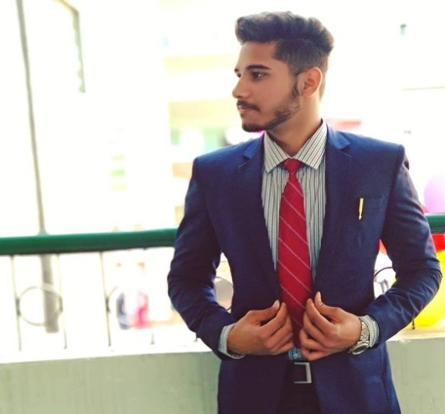
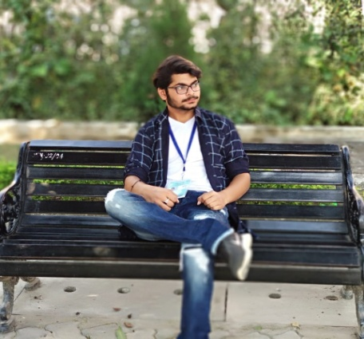
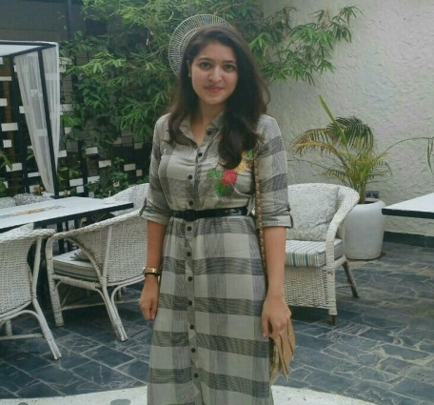
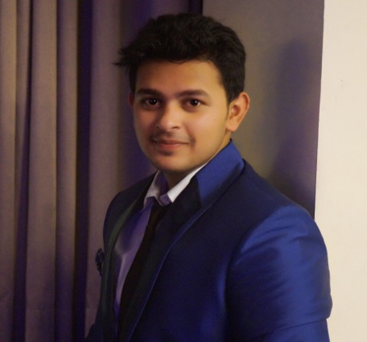
Officers
President (founder)
Umar Alam Siddiqui
Vice President
(Co- founder)
Parv Agarwal
Secretary
(Co- founder)
Shristhi Pahwa
Treasurer
(Co-founder)
Mohd Hamzah Siddiqui

Slide 15
Faculty and Mentors
Dr. Mukesh Rawat
Dr. Shashwat Pathak

Slide 16


